Slide 1
Ya gotta make it obvious
Terence Parr
MSDS program University of San Francisco

Slide 2
A bit of background…
I'm retooling as a machine learning droid after an entire career in parsing and programming language implementation (you might know me as "the ANTLR guy")
Since I'm no longer subject to the paper count treadmill, I'm exploring less traditional scholarly work, such as creating state-of-the-art visualizations and animations to explain machine learning concepts and models: https://explained.ai/
My mission is to explain complex topics deeply, but in the simplest possible way, and to build useful libraries to help the research and education community

Slide 3
What's wrong w/traditional academic output?
The goal of academic research papers and instruction is to transmit ideas, but…
Peer review and our egos often work against this goal because they are the enemy of simplicity and clarity
We fear that simplicity implies small research contribution and we also want to impress our audience with our brilliance
Therefore, we "math it up" or simply don't bother spending time to make our techniques or results clear
We should value simple and clear expositions most of all, for both large and small contributions, even if it's lots of extra work
Try to illuminate not impress!

Slide 4
Clarity through visualizations
Half the human cortex is devoted to understanding our world visually
Let's leverage that to understand, teach, and debug computational abstractions, such as machine learning models
We should not accept the status quo, and constantly ask ourselves if these are the best explanations and visualizations we can make
When learning, always ask why or how something works otherwise we don't really understand; don't just memo the math
Visualizing the why or how often leads to the best explanation

Slide 5
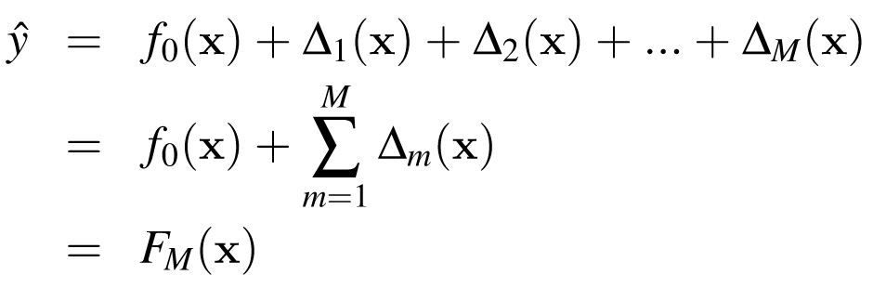
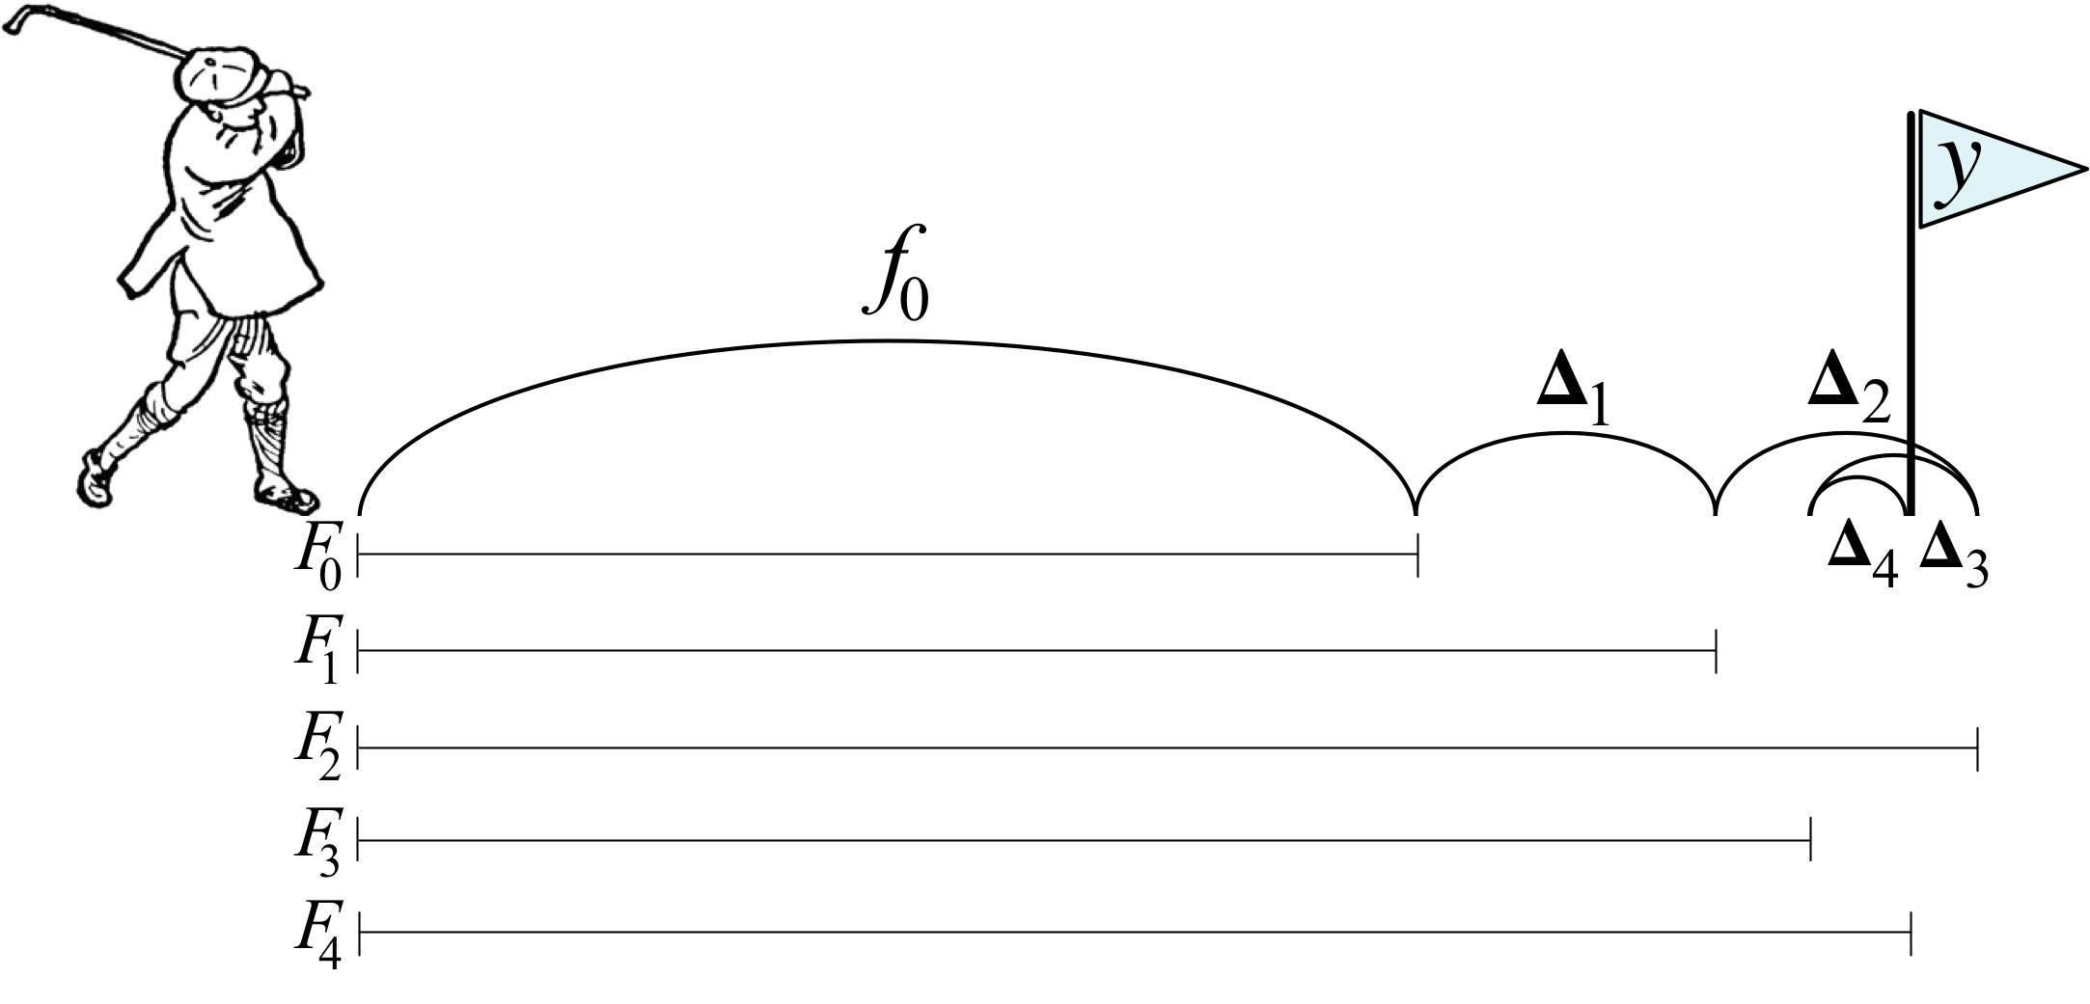
Explaining gradient boosting
Boosting as an additive model and we all show the math first:
We'd be embarrassed to put a cartoon like this in a paper or lecture, but my students tell me this explains the concept very clearly
Golfer clipart from http://etc.usf.edu/clipart/

Slide 6
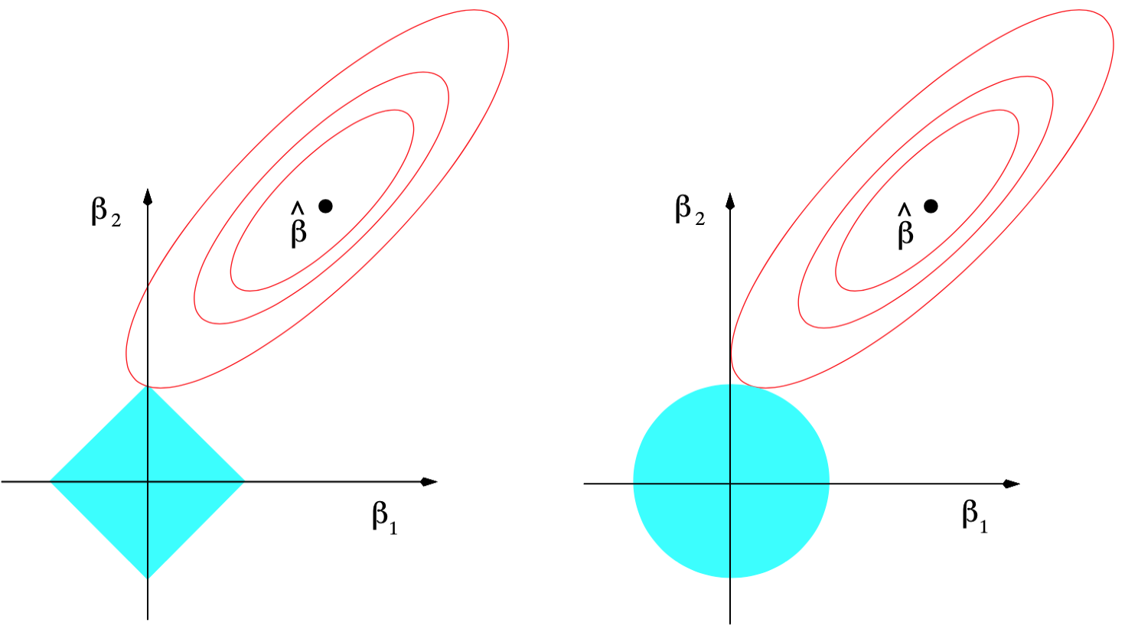
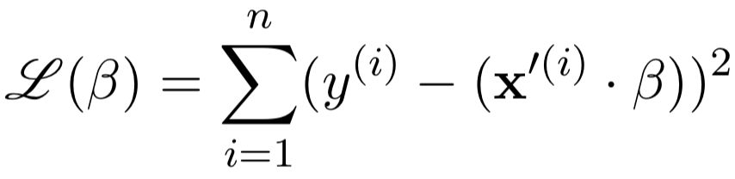
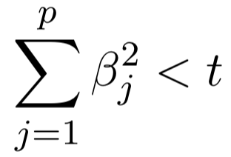
Just because it's visual doesn't mean it's good
Viz meant to help explain L1 vs L2 regularization
ESL is a great book, but these visualizations never helped me
Why here?
subject to
L1 regularization (lasso)
L2 regularization (ridge)
Fig 3.11, Page 71 Elements of Statistical Learning

Slide 7
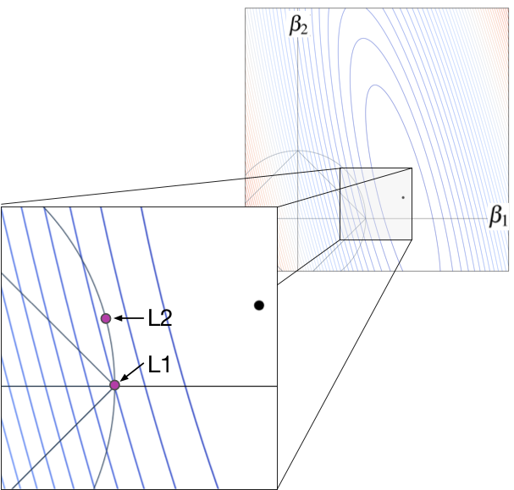

Better L1 vs L2 explanation
Loss function with two parameters
higher lower
min
Any movement of ($β_{1},β_{2}$) away from purple dots increases the loss;
left of any contour line is higher loss
From https://explained.ai/regularization/index.html

Slide 8
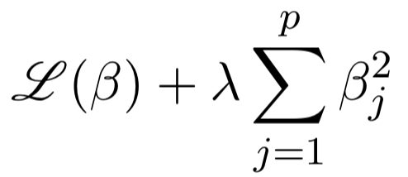
Soft constraints for L1, L2
Those circular and diamond-shaped hard constraints are how we understand regularization conceptually
But we implement by augmenting the loss function, yielding soft constraints
subject to
Changing 𝜆 only to increase regularization penalty
Becomes
Considerable effort to get the right viz idea and implement animations etc.

Slide 9
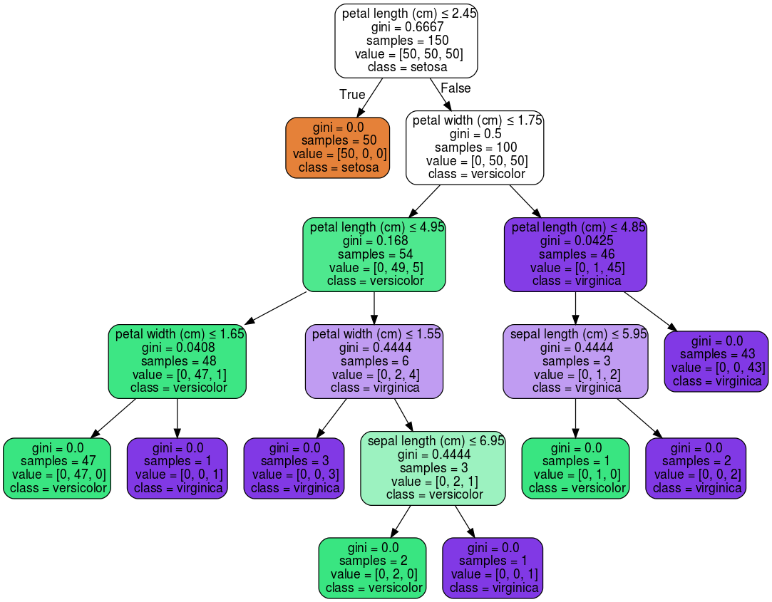
Decision trees should show feature splitting
This shows the tree structure but that's not what we really care about
What do those colors mean?
Careful thought required here; decisionmaking isn't obvious
Trees tesselate feature space, each node partitions a single var at a specific feature value
Nodes indicate var/value, but why was that value chosen?
Toy iris data set,
sklearn viz

Slide 10
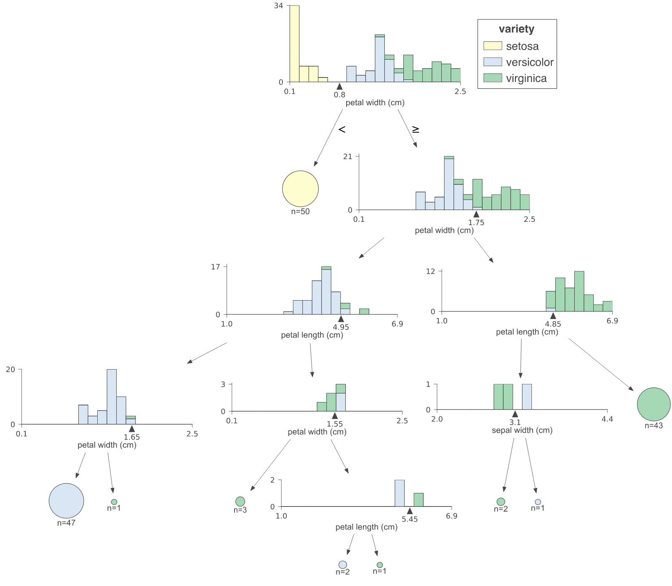
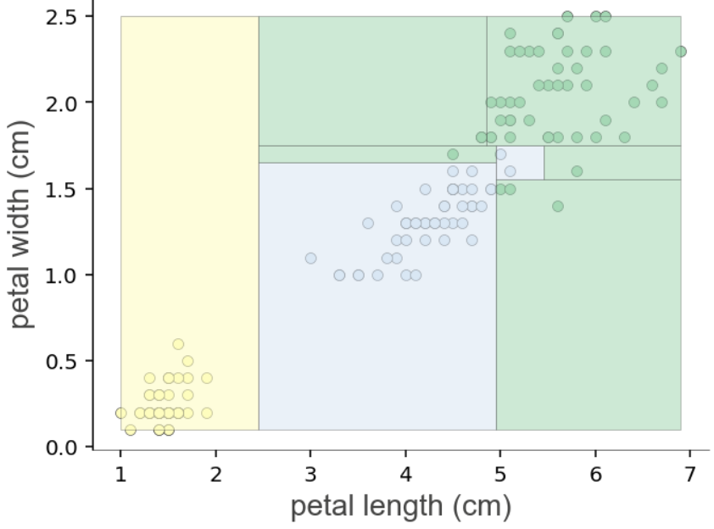
Should illustrate why/how
Split point rationale is now obvious
See https://explained.ai/decision-tree-viz/index.html

Slide 11
Debugging matrix algebra in Python
We often get less than helpful exception messages:
C++?
h_ = torch.tanh(Whh_ @ (r*h) + Uxh_ @ X.T + bh_)
RuntimeError: size mismatch, m1: [764 x 256], m2: [764 x 200] at /tmp/pip-req-build-as628lz5/aten/src/TH/generic/THTensorMath.cpp:41
It's not obvious why/where expression failed; we need to know which operator and operands; TensorSensor generates:
Cause: @ on tensor operand Uxh_ w/shape [764, 256]
and operand X.T w/shape [764, 200]
See https://explained.ai/tensor-sensor/index.html

Slide 12
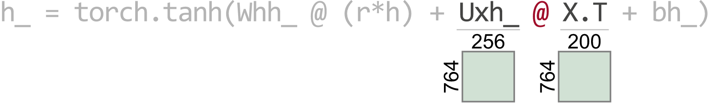
Better yet: make it obvious with viz
Cause: @ on tensor operand Uxh_ w/shape [764, 256]
and operand X.T w/shape [764, 200]
(Notice the details like highlighting, color, and de-highlighting)

Slide 13
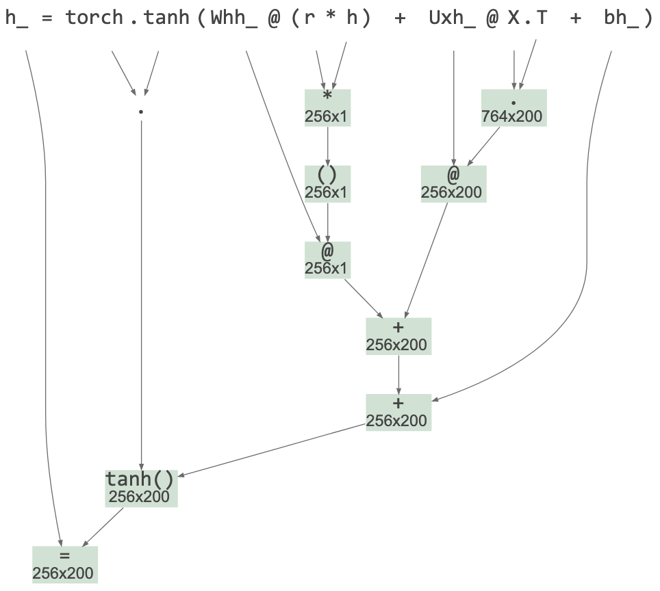
Aid for reading matrix code
What do we care about when reading complex matrix expressions?
We need the shape of all subexpressions
Abstract syntax tree gives us the right visualization with dimensions

Slide 14
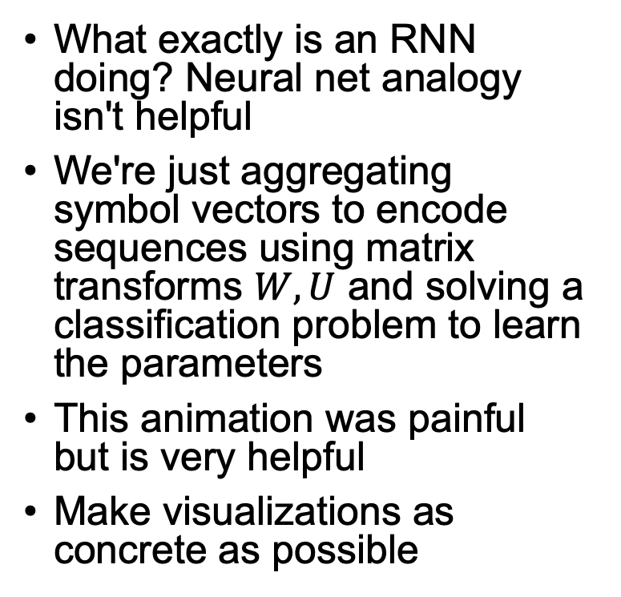
RNNs: Strip away the mysticism
What exactly is an RNN doing? Neural net analogy isn't helpful
We're just aggregating symbol vectors to encode sequences using matrix transforms $W,U$ and solving a classification problem to learn the parameters
This animation was painful but is very helpful
Make visualizations as concrete as possible
(Notice weights W,U,V flash when updated)
See https://explained.ai/rnn/index.html

Slide 15
Some advice
Sometimes you are right and everyone else is wrong, particularly blogs on the net
Look for the pain; then ease that pain. Build things you will use which means others will find it useful
Can't create what you can't imagine
Don't be guided by what is possible or what you know how to build; should for the best possible viz you can think of
Be tenacious! Never let the computer win; dtreeviz pathological determination and a trail of dead code left along the circuitous path to success
Experiment/explore. Don't know what is good until you see samples
Be skeptical
Don't start with the math (the solution); re-drive everything.

Slide 16
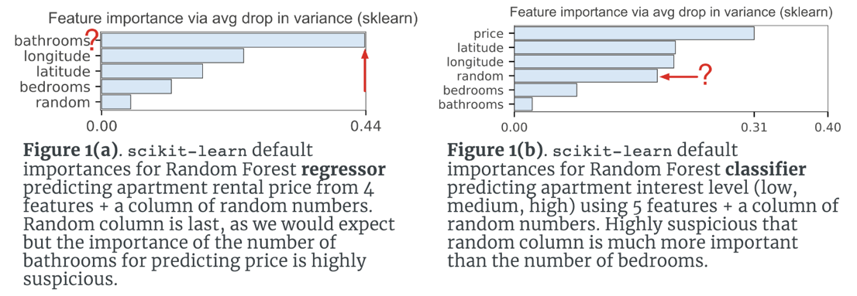
be skeptical
sometimes everybody else is wrong
MAPE? ROC?

Slide 18
Sometimes you are right and everyone else is wrong, particularly blogs on the net
be skeptical; Question everything; MAPE, ROC, log loss
Automate so that you can keep using the visualization: be good to your future self!
Don't start with the math (the solution); re-drive everything. Neg log loss a good one
Strive to understand everything deeply so that you can find the key nut in order to describe it
Took me a year to get the regularization picture
Implement if you want to understand; Feynman quote
Look for the pain; then ease your pain. Build things you will use which means others will find it useful
Can't create what you can't imagine
Don't be guided by what is possible or what you know how to build; should for the best possible viz you can think of
Be tenacious! Never let the computer win
Experiment/explore. Don't know what is good until you see samples
Sometimes solving a programming problem is less about algorithms and more about working within the constraints and capabilities of the programming ecosystem, such as tools and libraries. Dtreeviz Generating high quality vector-based images also required pathological determination and a trail of dead code left along the circuitous path to success.

Slide 19
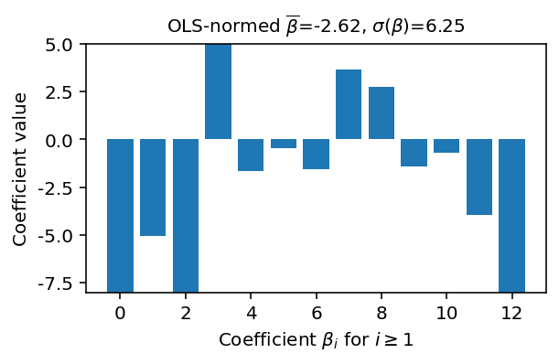
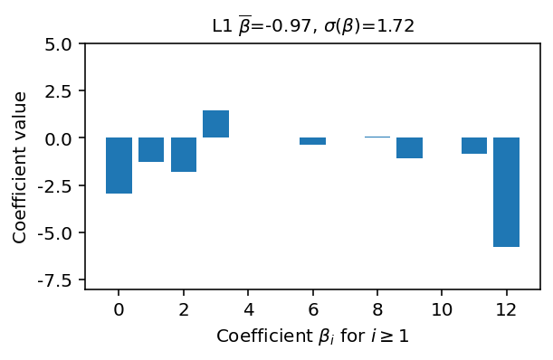
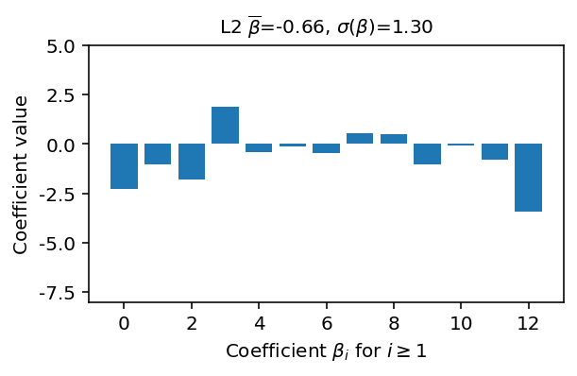
Demonstrate effect of regularization

